Slide 1

LOOP STATEMENT
LOOP Control STATEMENT

Slide 2
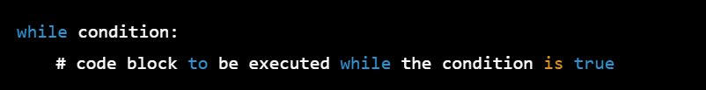
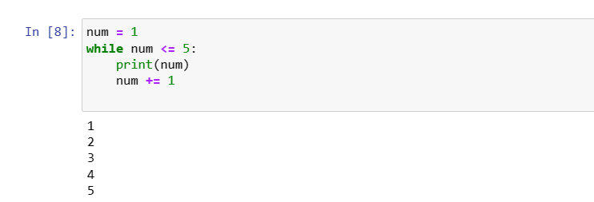
DETAIL OF WHILE LOOP:
The while loop is a control flow statement that allows you to execute a block of code repeatedly as long as a specified condition is true. The general syntax of a while loop in Python is:

Slide 3
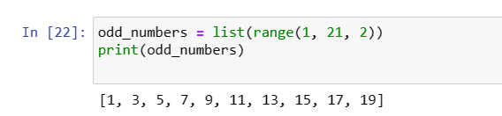
THE RANGE () FUNCTION
The range() function in Python is used to generate a sequence of numbers. It takes three arguments: start, stop, and step. The start argument is optional and defaults to 0, while the step argument is also optional and defaults to 1. The stop argument is required and specifies the upper limit of the sequence, but this upper limit is not included in the sequence.

Slide 4

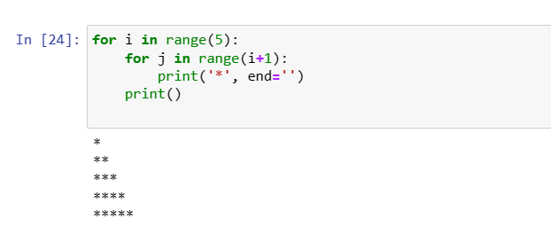
THE FOR LOOP
The for loop is a control flow statement in Python that allows you to iterate over a sequence of elements, such as a list, tuple, string, or range. The general syntax for a for loop in Python is as follows:

Slide 5
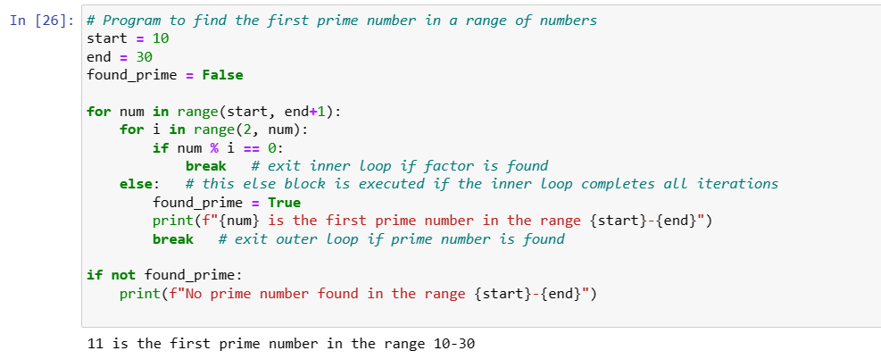
THE BREAK STATEMENT
In Python, the break statement is used to exit a loop prematurely, before the loop has completed all iterations. The break statement is usually placed inside a conditional statement, and when executed, it causes the loop to terminate immediately and execution continues with the next statement after the loop.

Slide 6
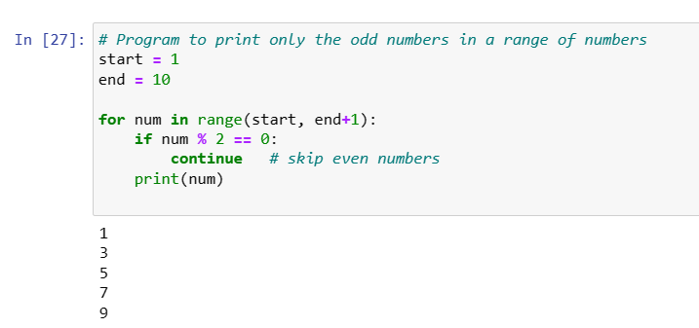
THE CONTINUE STATEMENT
In Python, the continue statement is used to skip the current iteration of a loop and move on to the next iteration, without executing any of the remaining statements in the loop for the current iteration. The continue statement is usually placed inside a conditional statement, and when executed, it causes the loop to skip the current iteration and move on to the next iteration.

Slide 7
What are Data Structures?
• Data structures help us store and organize data efficiently. • Python provides built-in data structures. • They allow us to store multiple values in one variable. • Useful for data analysis and programming tasks.
Main Python Data Structures:
• Lists • Tuples • Sets • Dictionaries

Slide 8
Lists in Python – Introduction & Creating Lists
• A list is a collection of items stored in an ordered sequence. • Lists are mutable, meaning we can add, remove, or change elements. • Lists allow duplicate values. • Elements are written inside square brackets [ ]. • Lists can store different data types (numbers, strings, booleans).
Example:
fruits = ["apple", "banana", "mango"] numbers = [10, 20, 30] mixed = [10, "Python", True] print(fruits) Real-life Example: • A shopping list or list of students in a class.

Slide 9
List Indexing, Slicing & Methods
• Indexing → Access elements using their position. • Python list index starts from 0. • Slicing → Extract a part of the list. • Lists provide built-in methods to modify data. • Common methods: append(), remove(), pop(), sort()
Example:
numbers = [10, 20, 30, 40, 50] print(numbers[0]) # Indexing print(numbers[1:4]) # Slicing numbers.append(60) numbers.remove(20) print(numbers)
.

Slide 10
Dictionary in Python
A dictionary is a data structure used to store data in key–value pairs.
Each key is used to access its corresponding value.
Dictionaries are written using curly braces {}.
Example
student = {
"name": "Rahul",
"age": 21,
"course": "BBA"
}
Output
{'name': 'Rahul', 'age': 21, 'course': 'BBA'}

Slide 11
Key Features of Dictionary
A dictionary is a data structure used to store data in key–value pairs.
Each key is used to access its corresponding value.
Dictionaries are written using curly braces {}.
Example
student = {
"name": "Rahul",
"age": 21,
"course": "BBA"
}
Output
{'name': 'Rahul', 'age': 21, 'course': 'BBA'}

Slide 12
Accessing Dictionary Values
We access dictionary values using keys.
Syntax
dictionary[key]
Example
student = { "name": "Rahul", "age": 21, "course": "BBA" } print(student["name"]) print(student["age"])
Output
Rahul 21

Slide 13
Adding and Updating Values
We can add or modify values in a dictionary.
Example
student = { "name": "Rahul", "age": 21 } student["city"] = "Delhi" student["age"] = 22 print(student)
Output
{'name': 'Rahul', 'age': 22, 'city': 'Delhi'}

Slide 14
Removing Items from Dictionary
We can add or modify values in a dictionary.
Example
student = { "name": "Rahul", "age": 21 } student["city"] = "Delhi" student["age"] = 22 print(student)
Output
{'name': 'Rahul', 'age': 22, 'city': 'Delhi'}

Slide 15
Removing Items from Dictionary
Common methods to remove elements:
pop()
del
clear()
Example
student = { "name": "Rahul", "age": 21, "city": "Delhi" } student.pop("age") print(student)
Output
{'name': 'Rahul', 'city': 'Delhi'}

Slide 16
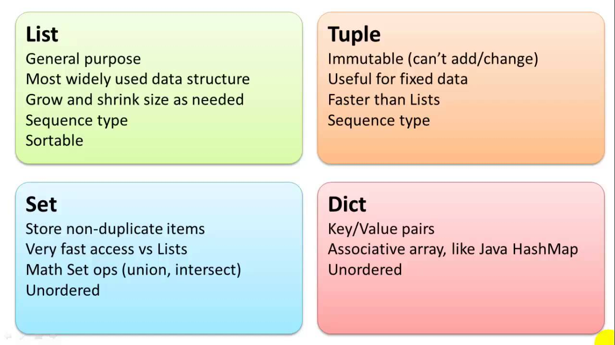
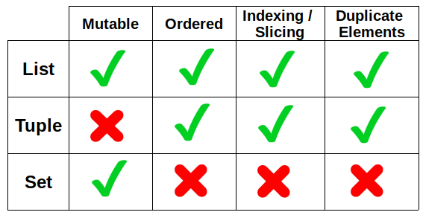
LIST, TUPLE, DICTIONARY, SETS

Slide 17
FUNCTION
FUNCTION USING PYTHON

Slide 18
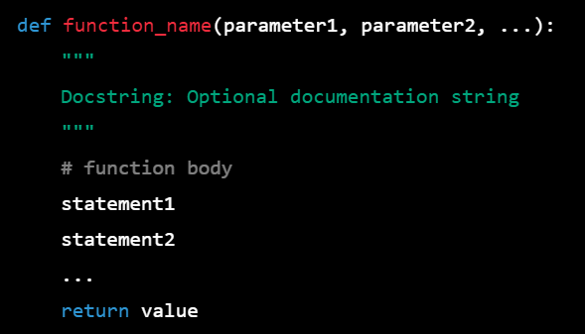
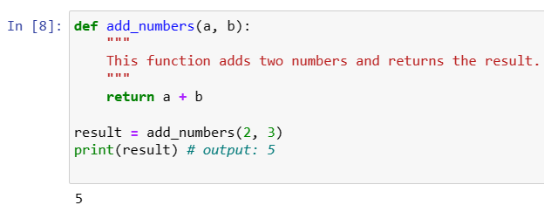
SYNTAX AND BASICS OF A FUNCTION
In Python, a function is a block of code that performs a specific task. Functions are defined using the def keyword, followed by the function name, a set of parentheses, and a colon. The body of the function is indented and contains the code that performs the task.

Slide 19
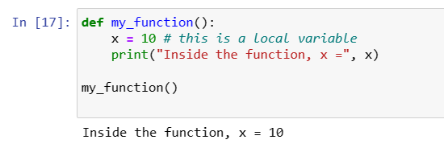
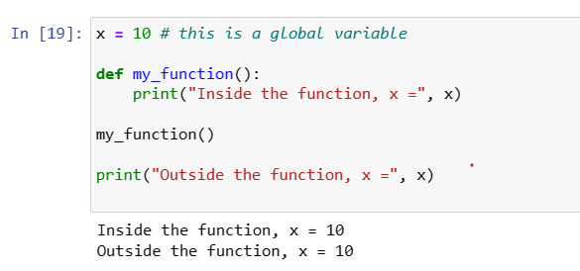
THE LOCAL AND GLOBAL SCOPE OF A VARIABLES
In Python, variables can have either local or global scope. The scope of a variable refers to the parts of the program where that variable can be accessed.
Local Variables:
Local variables are variables that are declared inside a function. They are only accessible within the function in which they are defined. Here is an example:
Global Variables:
Global variables are variables that are declared outside of any function, and can be accessed from anywhere in the program. Here is an example:

Slide 20
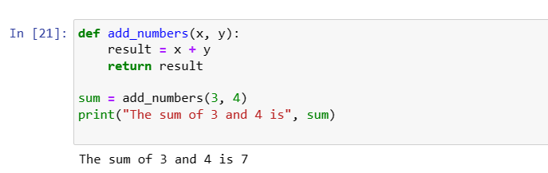
THE RETURN STATEMENT
In Python, the return statement is used to return a value from a function. When a function is called, it may perform some operations and produce a result. This result can be returned to the caller using the return statement.
Here is an example:

Slide 21
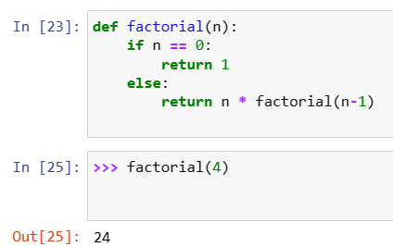
RECURSIVE FUNCTION
A recursive function in Python is a function that calls itself during its execution. This can be useful when we need to perform the same task repeatedly, with slightly different inputs each time. Recursive functions can be a powerful tool for solving complex problems, but they can also be tricky to implement correctly.
Here's an example of a simple recursive function in Python that calculates the factorial of a number:

Slide 22
RECURSIVE FUNCTION
A recursive function in Python is a function that calls itself during its execution. This can be useful when we need to perform the same task repeatedly, with slightly different inputs each time. Recursive functions can be a powerful tool for solving complex problems, but they can also be tricky to implement correctly.
Here's an example of a simple recursive function in Python that calculates the factorial of a number:

Slide 23
Modules in Python
What is a Module?
A module is a Python file that contains code such as:
functions
variables
classes
It helps us reuse code in multiple programs.
Why Use Modules?
Organize large programs
Avoid writing the same code again
Make programs easier to manage
Example
import math print(math.sqrt(16))
Output
4.0

Slide 24
Ways to Import Modules
1. Import Entire Module
import math print(math.sqrt(25))
2. Import Specific Function
from math import sqrt print(sqrt(25))
3. Import with Alias
import math as m print(m.sqrt(36))
Why Alias?
Shorter names
Easier to write code

Slide 25
Creating Your Own Module
A module is simply a Python file
Example file:
calculator.py
calculator.py
def add(a, b): return a + b def subtract(a, b): return a – b
Using the Module
import calculator print(calculator.add(5,3))
Output
8

Slide 26
What is a Package?
A package is a folder that contains multiple Python modules.
Packages help organize large Python projects.
Example Package Structure
myproject │ ├── main.py │ └── math_operations ├── __init__.py ├── addition.py └── subtraction.py
Important File
__init__.py
tells Python that the folder is a package

Slide 27
Module vs Package
Feature | Module | Package
Definition | Python file | Folder of modules
Extension | .py | Folder
Purpose | Store functions/classes | Organize modules
Module → Python File
Package → Folder containing modules

